Slide 1

Credit Card Transaction Fraud Detection
.

Slide 2

Introduction
Credit card fraud refers to the unauthorized use of credit card information to make purchases or withdraw money. It is a significant problem for financial institutions and cardholders as it can result in financial losses, damaged credit scores, and a loss of trust in the financial system.
The dataset in question is highly imbalanced, with only a small fraction of transactions being fraudulent. This presents challenges for machine learning models as they may be biased towards the majority class and struggle to identify instances of the minority class.
Machine learning models can be trained on historical transaction data to identify patterns and flag potentially fraudulent transactions in real-time. However, it is crucial to ensure that the models are trained on balanced datasets and evaluated using appropriate metrics to avoid biased results and inaccurate predictions.

Slide 3
Motivation
Problem
Need
Solution
The rise of online shopping and contactless payments has made credit card fraud detection more challenging.
It is important that credit card companies can recognize fraudulent credit card transactions so that customers are not charged for items that they did not purchase.
Utilizing Machine Learning Algorithms to detect fraudulent transactions

Slide 4
Goal
Planning a Mechanism
To develop a model that can accurately distinguish fraudulent transactions from legitimate ones.
Selecting appropriate model
This can be achieved using various machine learning techniques such as Random Forest Algorithm, Multi-Layer Perceptron, Linear Regression, K-Means Clustering, etc.
Comparing the best model with optimal accuracy
By performing comparative analysis, one model out of the three can be identified as the optimal model.

Slide 5

implementation

Slide 6
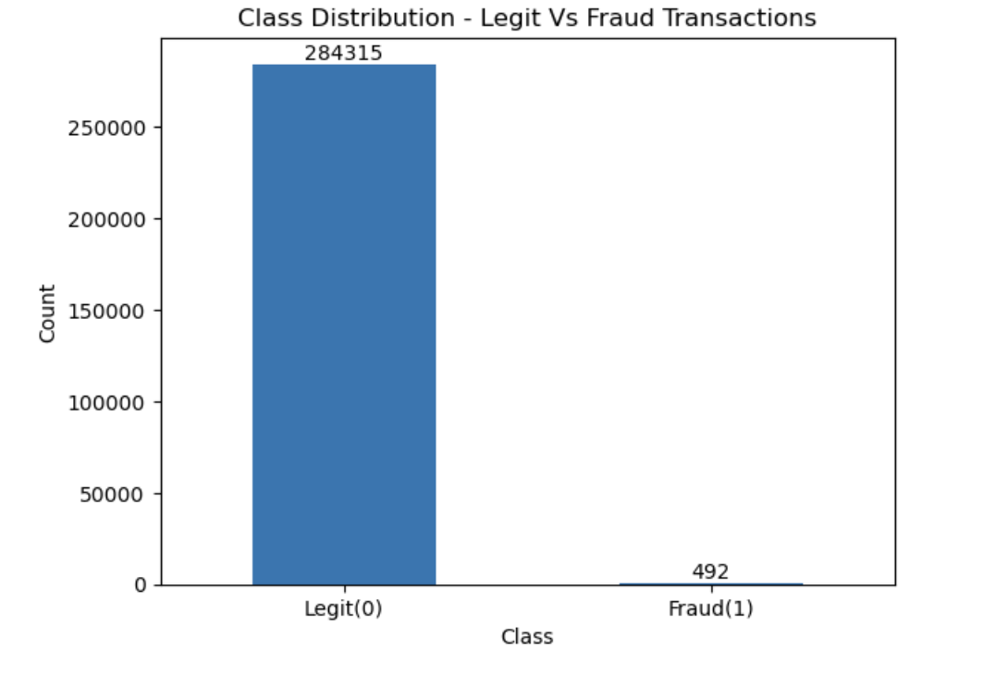
Dataset
Credit card transactions by European cardholders in September 2013 are contained in this dataset. A total of 492 frauds were detected out of 284,807 transactions that occurred over a two-day period. There is a high degree of unbalance in the dataset. There are 0.172% of all transactions that are classified as positive (frauds).
Several numerical variables are contained in it, which are the results of a PCA transformation. Data features, background information, and original features have unfortunately been withheld due to confidentiality issues. With PCA, the principal components are V1, V2, ... V28. The table below outlines the features that were not calculated through the PCA algorithm.

Slide 7
Methodology
Step 1
EDA with Visualization to understand the data
Step 2
Data Preprocessing
Step 3
Build models:
Random Forest
Linear Regress.
XGBoost
Step 4
Train the Models
&
Make Predictions
Step 5
Evaluate Model Performance
Step 6
Visualize Results

Slide 8

Exploratory
Data Analysis

Slide 9
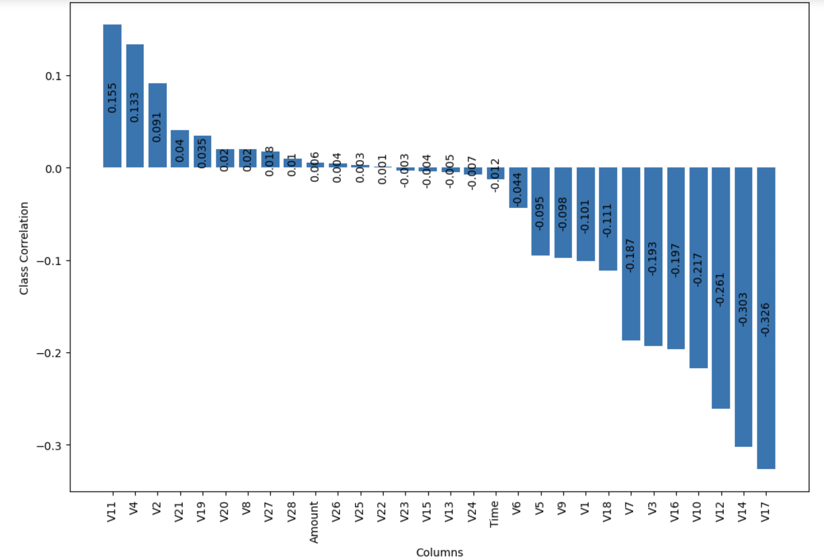
correlation with class

Slide 10
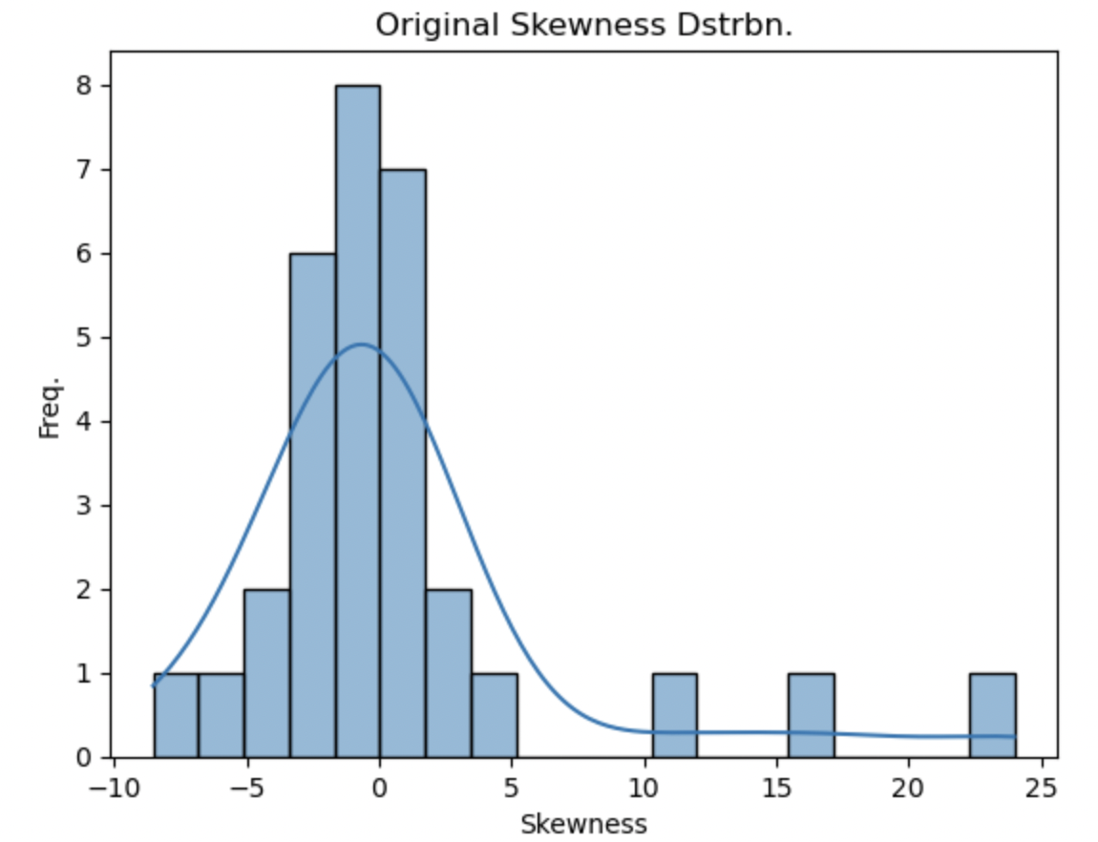
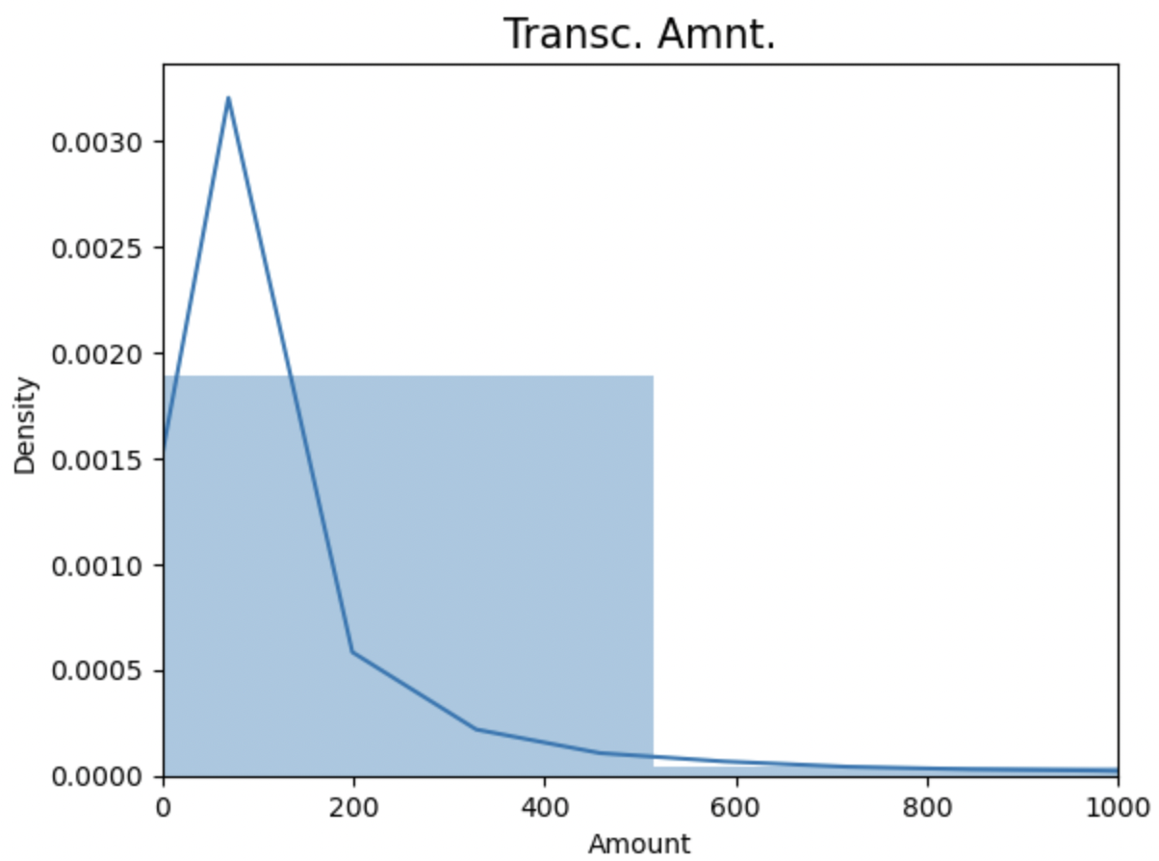
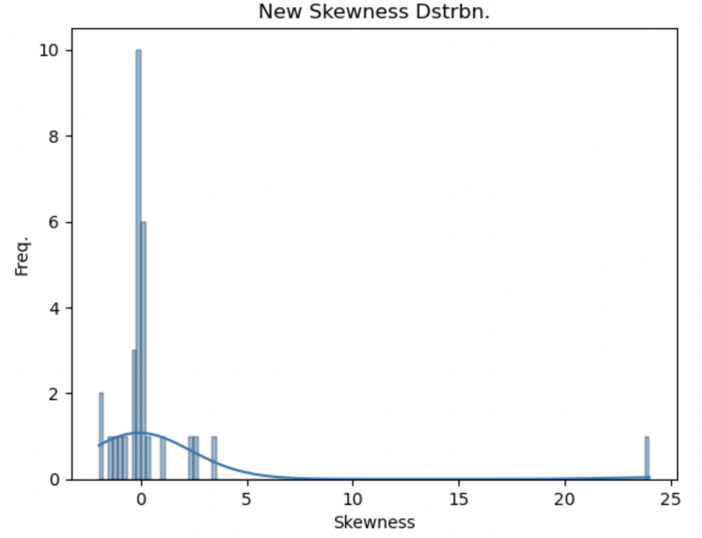
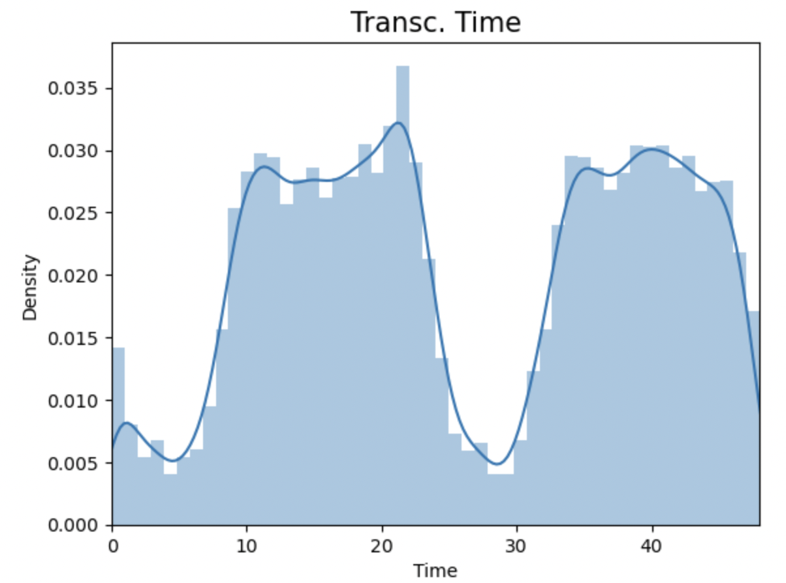
Skewness before applying Power Transformer
Distribution against Transaction Amount
Skewness after applying Power Transformer
Distribution against Transaction Time

Slide 11



Algorithms
Random Forest Classifier:
Random forest modeling is an ensemble machine learning technique that combines several decision trees to produce a more reliable and accurate prediction model. Feature subsampling and bootstrapping are used to introduce unpredictability and variety to the model, which helps to reduce overfitting and improve performance. Finally, the predictions from the different trees are combined using a majority vote or average to generate the final result.
Linear Regression:
Logistic regression is a popular supervised machine learning method that predicts a categorical outcome from a set of independent variables. It outputs probability values between 0 and 1, rather than precise values, enabling it to classify data as fraudulent or non-fraudulent. It's commonly used for binary classification tasks, such as True or False, Yes or No, or 0 or 1.
XGBoost:
XGBoost is an optimized implementation of the gradient boosting algorithm used for supervised learning tasks such as classification, regression, and ranking. It constructs an ensemble of decision trees, updating parameters with regularization and gradient descent. Due to its speed, accuracy, and advanced features, it is widely used in industries such as finance, healthcare, advertising, and recommendation systems.

Slide 12
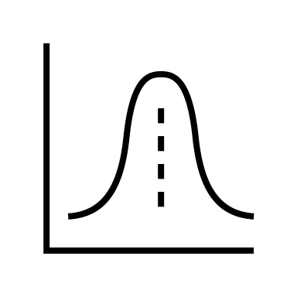
Sampling & results

Slide 13
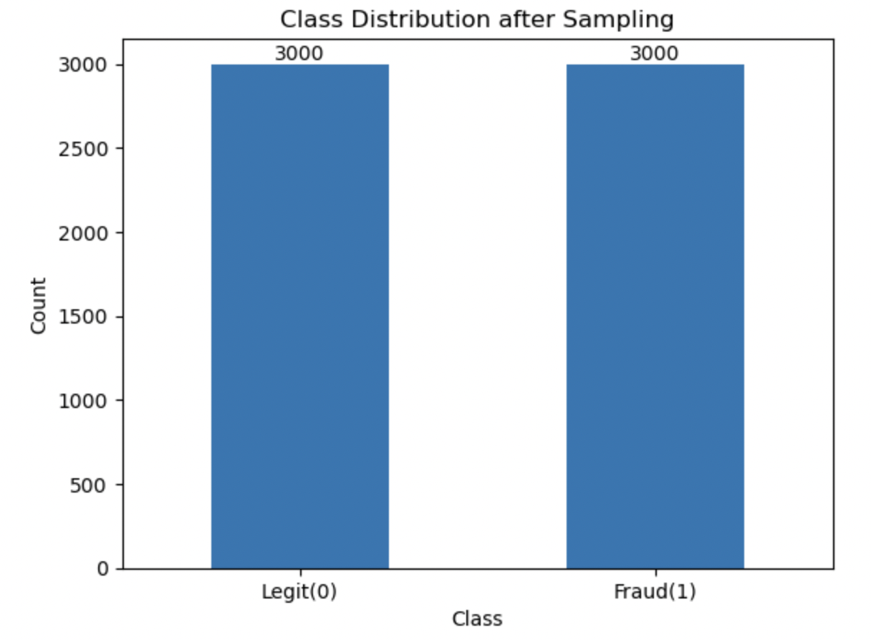
Sampling

Slide 14
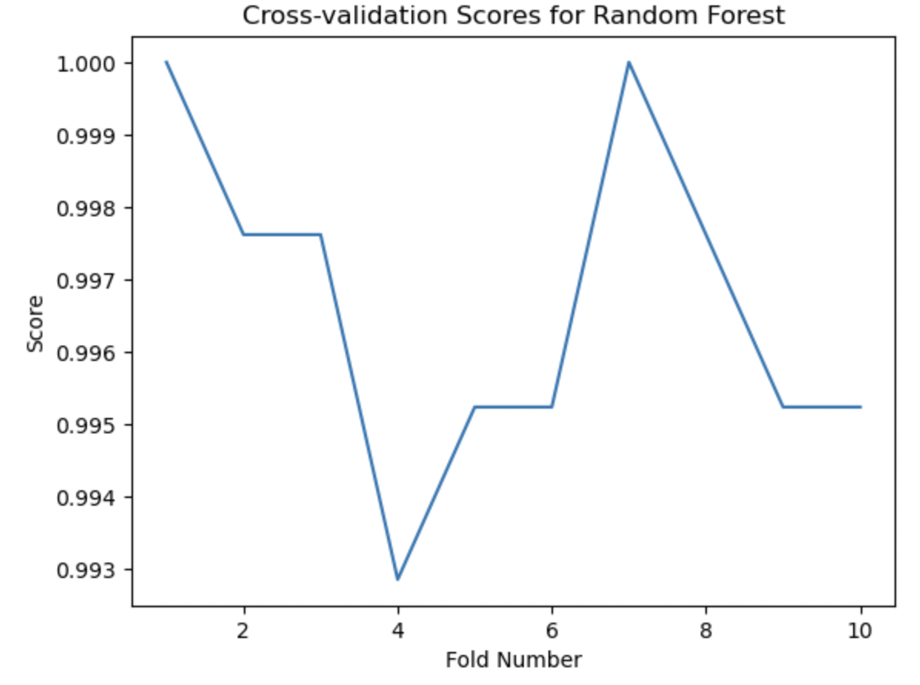
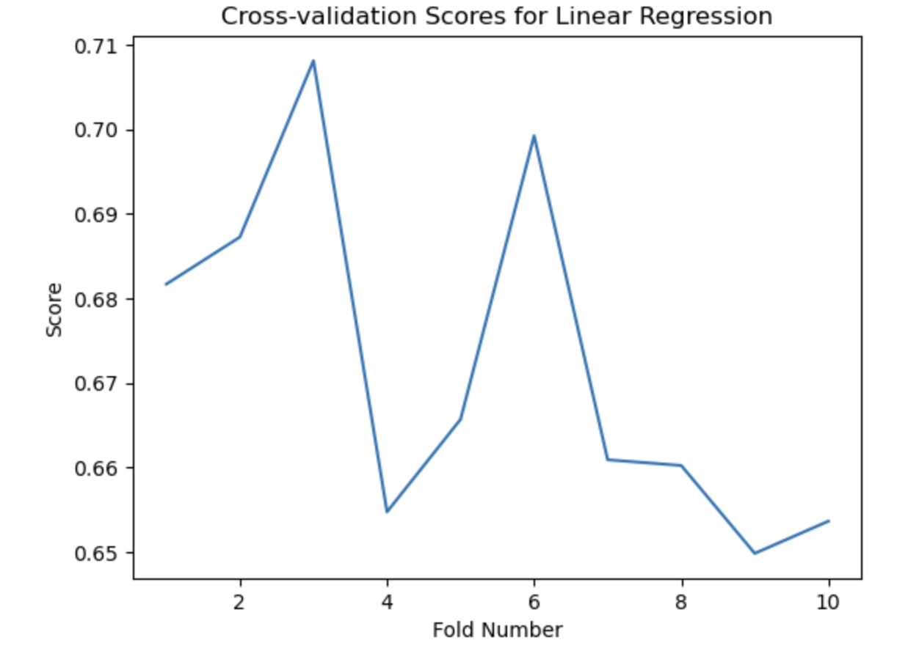
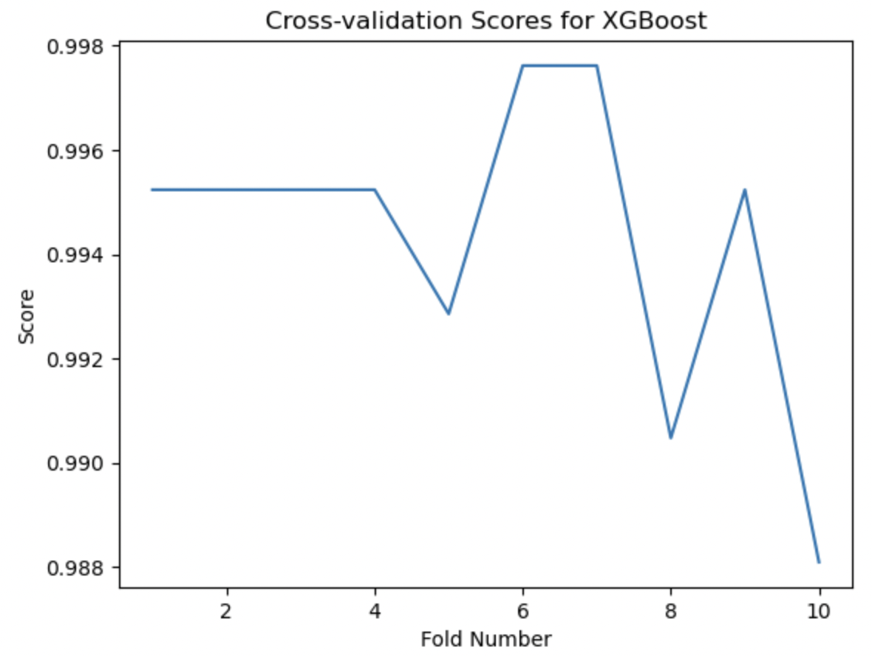
Cross-validation results
Random Forest Classifier
Linear Regression
XGBoost
Cross – Validation Score = 99.66%
Cross – Validation Score = 67.21%
Cross – Validation Score = 99.42%

Slide 15

Model evaluation

Slide 16
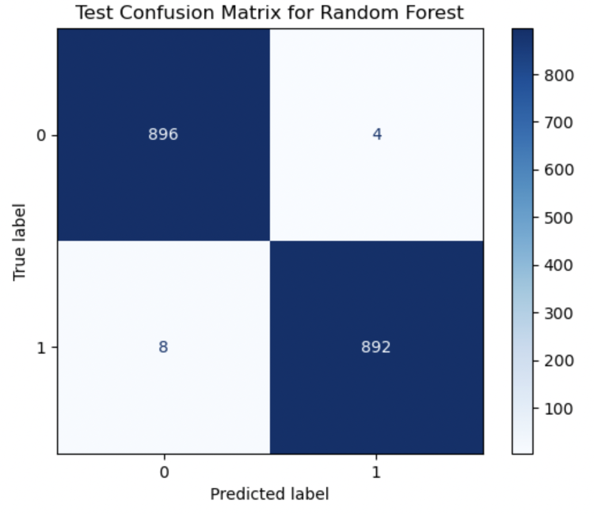
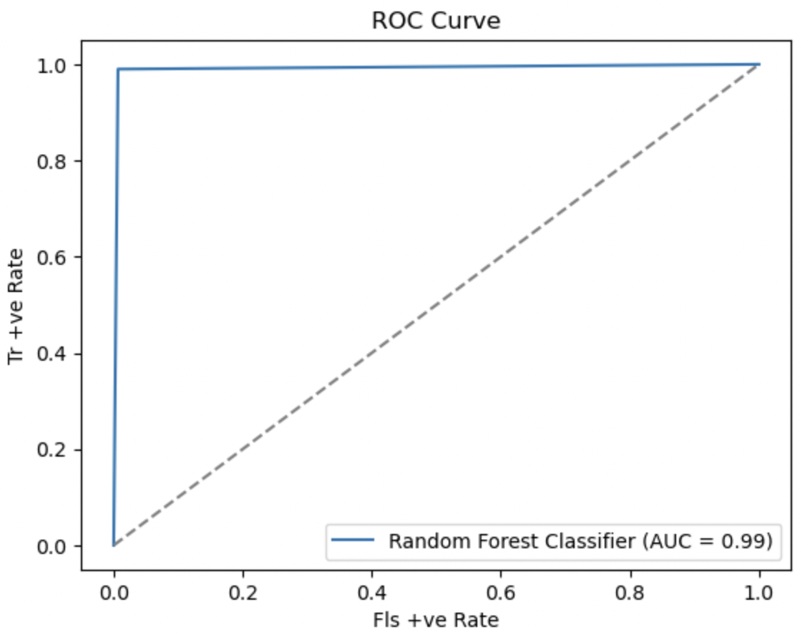
Random Forest

Slide 17
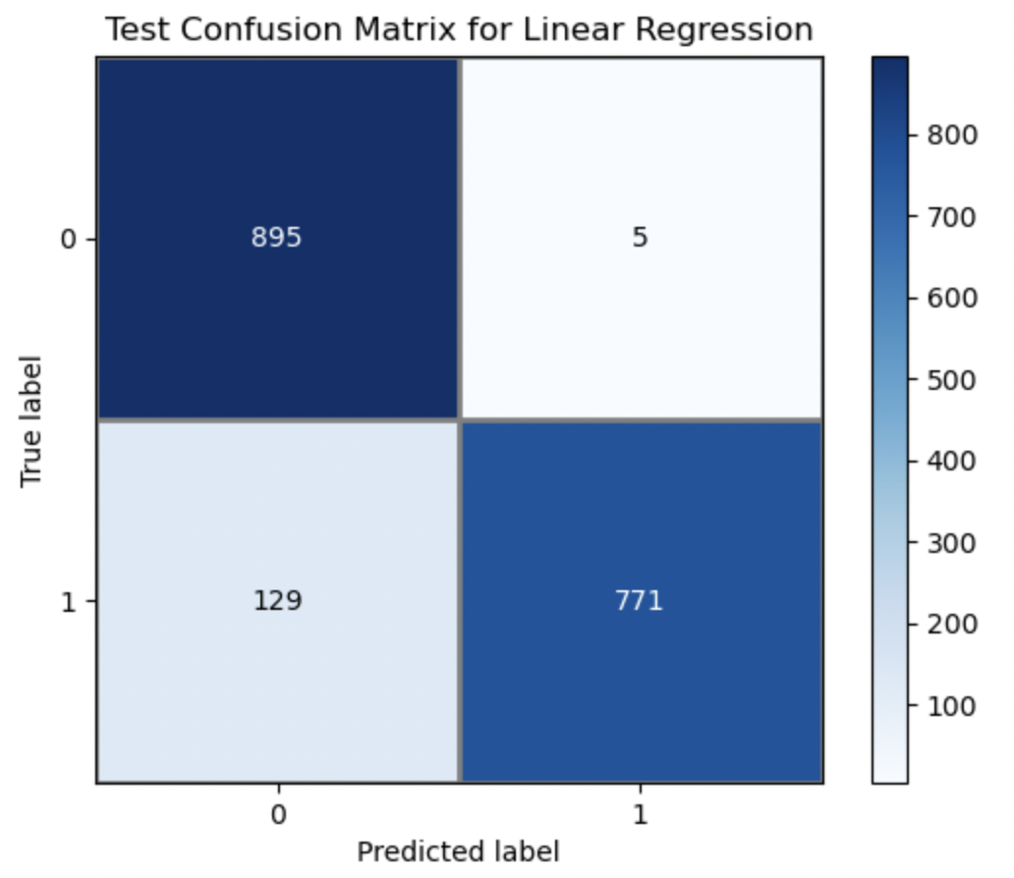
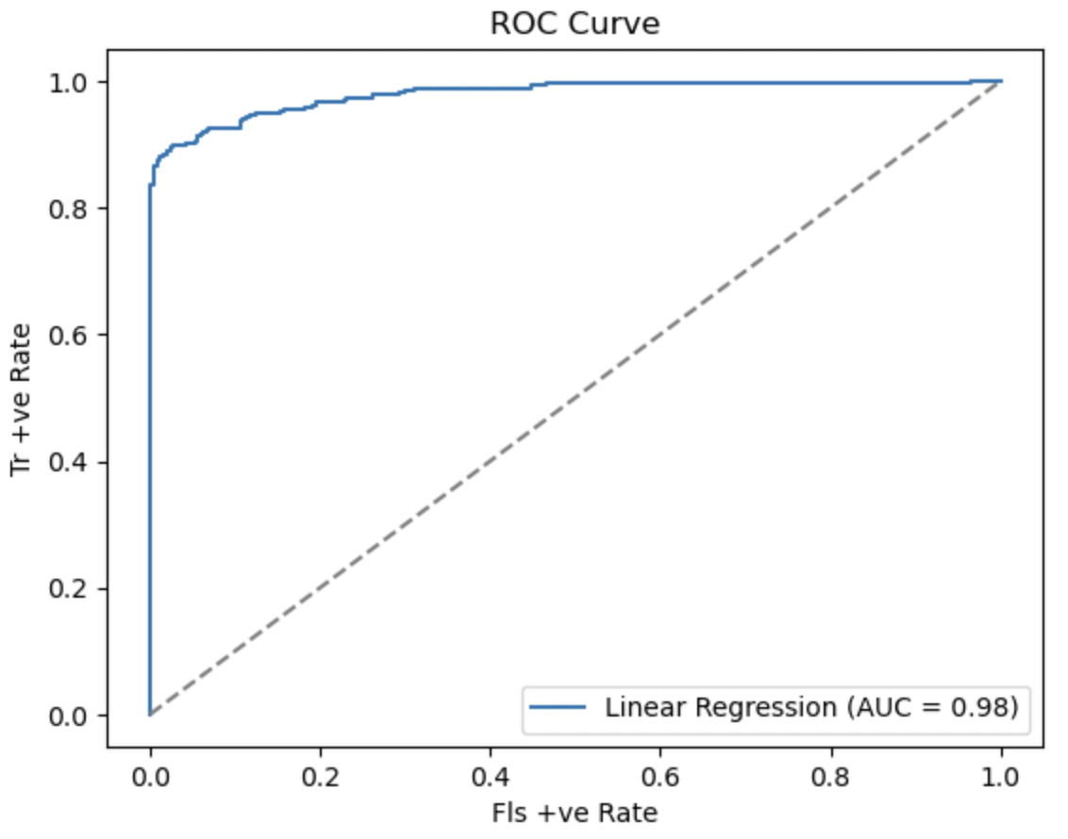
Linear regression

Slide 18
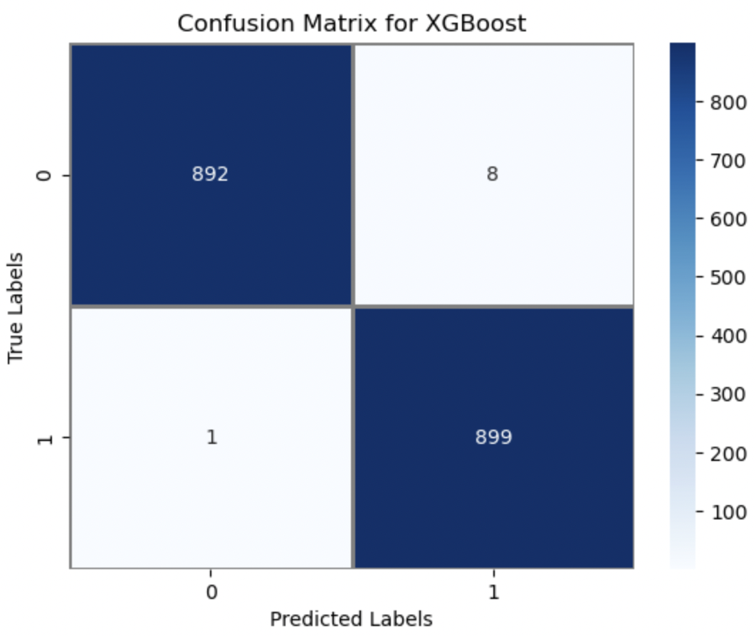
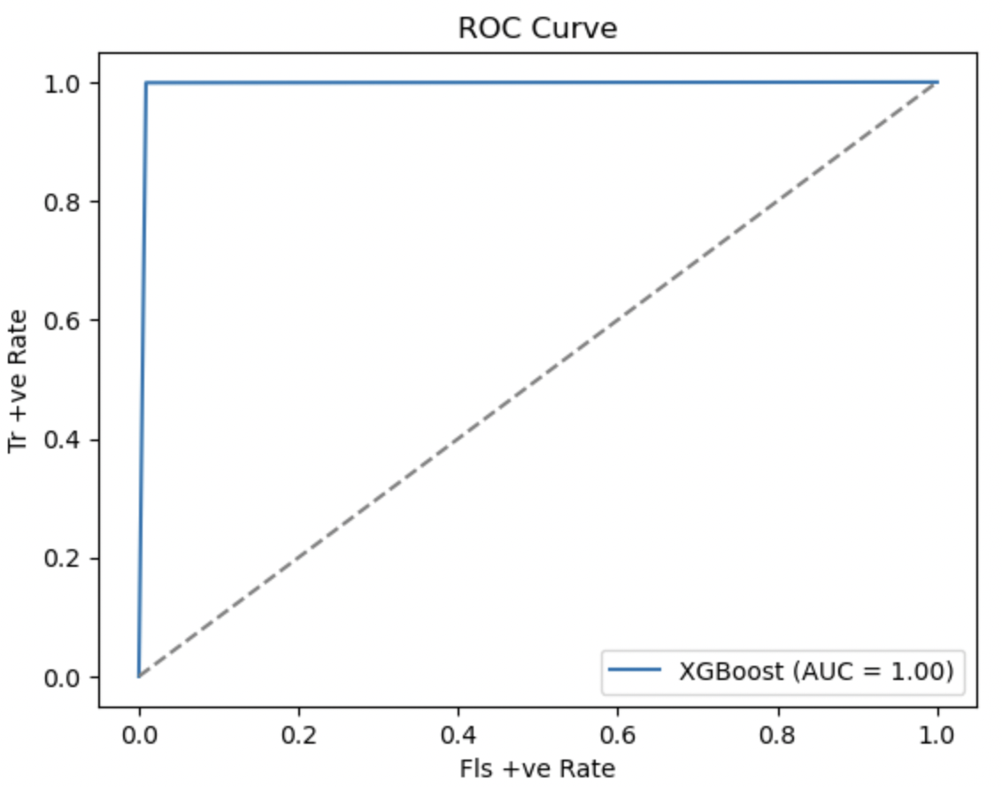
Xg boost

Slide 19

comparison

Slide 20
Comparative analysis
Random Forest Classifier
Linear Regression
XGBoost
Training Data
Class | Precision | Recall | F1-Score | Support
0 | 1.00 | 1.00 | 1.00 | 2100
1 | 1.00 | 1.00 | 1.00 | 2100
Accuracy = 100%
Training Data
Class | Precision | Recall | F1-Score | Support
0 | 0.88 | 0.99 | 0.93 | 2100
1 | 0.99 | 0.87 | 0.93 | 2100
Accuracy = 93.07%
Training Data
Class | Precision | Recall | F1-Score | Support
0 | 1.00 | 1.00 | 1.00 | 2100
1 | 1.00 | 1.00 | 1.00 | 2100
Accuracy = 100%
Overfits the Data
Accurate
Overfits the Data

Slide 21
Conclusion
In order to address the problem of data imbalance in the credit card fraud detection dataset, this research used three different models: Random Forest Classification, Linear Regression, and XGBoost. The real values were undersampled to 3000 while the fraudulent values were oversampled to 3000 in order to balance the imbalance. Then, a 70:30 split between the training and test sets was applied to the dataset.
The models were trained on the training set, and the accuracy of their predictions on the testing set was used to gauge their performance. When compared to the Linear Regression model, which performed well in terms of accuracy, precision, and how it appeared on the Confusion Matrix and ROC Curves, the Random Forest Classifier and XGBoost models showed overfitting.
Based on these results, it can be said that the Linear Regression model performed better than the other two models and is the best choice for this project's evaluation of credit card fraud transactions.

Slide 22
References
[1] Muaz, A., Jayabalan, M., & Thiruchelvam, V. (2020). A Comparison of Data Sampling Techniques for Credit Card Fraud Detection. International Journal of Advanced Computer Science and Applications, 11(6). https://doi.org/10.14569/ijacsa.2020.0110660
[2] Jake VanderPlas, Python Data Science Handbook.
[3] Shen, A., Tong, R., & Deng, Y. (2007). Application of Classification Models on Credit Card Fraud Detection. 2007 International Conference on Service Systems and Service Management.

Slide 23
Thank - you

